Slide 1






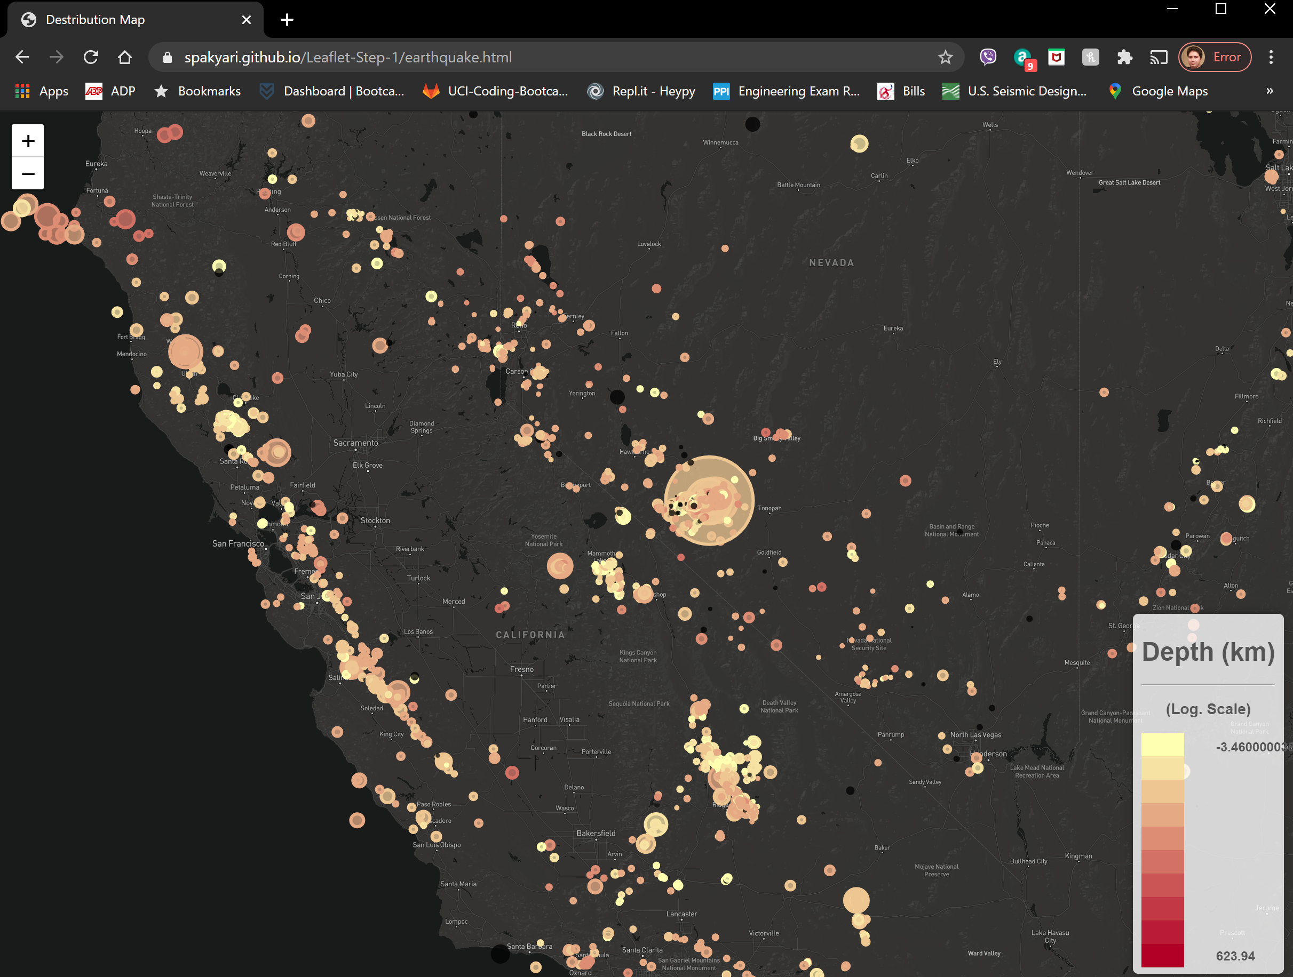
Feature Builder
& Data Labeler
Problem
(Labels + Features)
Sckit Learn
(Jupyter)
Machine Learning Model
USGS 50 years records
SQLite Database
Python
Numpy
SQL
Pandas
SQLalchemy
Lab-Work
Back-End
Front End
Flask app
JSON
Predictions
Deployed Model
Data Labeling
Feature Building
JSON
Last 30 days’ quakes

